Slide 1
Module 4: Lists
CS 5010 Program Design Paradigms “Bootcamp”
Combined Module 4 Lessons
© Mitchell Wand, 2012-2017
This work is licensed under a Creative Commons Attribution-NonCommercial 4.0 International License.
TexPoint fonts used in EMF.
Read the TexPoint manual before you delete this box.: AAA

Slide 2
Module 04
Data Representations
Design Strategies
Basics
Combine simpler functions
Generalization
Mixed Data
Over Constants
Use a template
Recursive Data
Over Expressions
Divide into Cases
Functional Data
Over Contexts
Call a more general function
Objects & Classes
Over Data Representations
Stateful Objects
Communicate via State
Over Method Implementations

Slide 3
Outline for the rest of this week
The arithmetic of lists
Using the list template
Lists of Structures

Slide 4
Key Points for this Lesson
At the end of this lesson, you should be able to:
Write down a data definition for information represented as a list
Notate lists using constructor, list, and write notations.
Explain how lists are represented as singly-linked data structures, and how cons, first, and rest work on these structures
Calculate with the basic operations on lists: cons, first, and rest .

Slide 5
Sequence Information
a phone book, which is a sequence of listings
a presentation, which is a sequence of slides
In Racket, these can be represented as lists.
for some applications, there are more efficient representations, but we’ll start with lists.

Slide 6
Lists: A Handy Representation for Sequences
Sequences of data items arise so often that Racket has a standard way of representing them.
Sequence information in Racket is most often represented by lists.
These are implemented as singly-linked lists, which you should have learned about in your data structures course.

Slide 7
Example Data Definition for Sequence Data
There are many ways to represent a sequence of numbers. Here we’ve chosen to represent a sequence as a singly-linked list.
DATA DEFINITION:
A NumberSeq is represented as a list of Number.
;; CONSTRUCTOR TEMPLATE:
;; empty -- the empty sequence
;; (cons n ns)
;; WHERE:
;; n is a Number -- the first number
;; in the sequence
;; ns is a NumberSeq -- the rest of the
;; numbers in the sequence
empty and cons are built into Racket. We don’t need any define-structures for them
We’ll deal with the observer template a little later.

Slide 8
Examples of NumberSeq:
empty
(cons 11 empty)
(cons 22 (cons 11 empty))
(cons 33 (cons 22 (cons 11 empty)))
(cons 33 empty)
A NumberSeq is one of:
-- empty
-- (cons Number
NumberSeq)
Here are some examples of NumberSeqs.
empty is a NumberSeq by the data definition.
(cons 11 empty) is a NumberSeq because 11 is a number and empty is a NumberSeq.
(cons 22 (cons 11 empty)) is a NumberSeq because 22 is a number and (cons 11 empty) is a NumberSeq.
And so on.

Slide 9
DigitSequence
A Digit is one of
"0" | "1" | "2" | ... | "9"
A DigitSequence (Dseq) is represented
as a listof Digit.
CONSTRUCTOR TEMPLATES:
-- empty
-- (cons Digit DSeq)
Let's do it again, this time with digits.
We define a Digit to be one of the strings "0", "1", etc., through "9".
A DigitSequence(DSeq) is either empty or the cons of a Digit and a DSeq.

Slide 10
Examples of DSeqs
empty
(cons "3" empty)
(cons "2" (cons "3" empty))
(cons "4" (cons "2" (cons "3" empty)))
These are not DSeqs:
(cons 4 (cons "2" (cons "3" empty)))
(cons (cons "3" empty)
(cons "2" (cons "3" empty)))
A DigitSequence (DSeq) is one of:
-- empty
-- (cons Digit DSeq)
Can you explain why each of the first 4 examples are DSeq’s, according to the data definition?
Can you explain why the last two are not Dseq’s?

Slide 11
These data definitions are self-referential
A NumberSeq is one of:
-- empty
-- (cons Number NumberSeq)
The data definition for NumberSeqs contains something we haven't seen before: self-reference.
The second constructor uses NumberSeq, even though we haven't finished defining NumberSeqs yet. That's what we mean by self-reference.
In normal definitions, this would be a problem: you wouldn’t like a dictionary that did this.
But self-reference the way we've used it is OK. We've seen in the examples how this works: once you have something that you know is a NumberSeq, you can do a cons on it to build another NumberSeq. Since that's a NumberSeq, you can use it to build still another NumberSeq.
We also call this a recursive data definition.

Slide 12
This one is self-referential, too
A Digit is one of
"0" | "1" | "2" | ... | "9"
A DigitSequence (DSeq) is one of:
-- empty
-- (cons Digit DSeq)

Slide 13
How Lists Represent Sequences
If X is some data definition, we define a list of X's as either empty or the cons of an X and a list of X's.
So a list of sardines is either empty or the cons of a sardine and a list of sardines.
The interpretation is always "a sequence of X's".
empty represents a sequence with no elements
(cons x lst) represents a sequence whose first element is x and whose other elements are represented by lst.
If we had some information that we wanted to represent as a list of X's (say a list of people), we would have to specify the order in which the X's appear (say "in increasing order of height"), or else say “in any order.”

Slide 14
The constructor template for list data
CONSTRUCTOR TEMPLATES:
-- empty
interp: a sequence of X's with no elements
-- (cons X XList)
interp: (cons x xs) represents a sequence of X's
whose first element is x and whose
other elements are represented by xs.
We use xs (pronounced "ex's") as the plural of "x".

Slide 15
Collection Information
Sometimes we are interested in representing a set, which may not have a built-in notion of order
a space-invaders game with many invaders
a book-store inventory with many books
You can use lists to represent these as well.
You will need to specify the order
This will be part of the data definition

Slide 16
Example Data Definition for Collection Information
;; An Inventory is represented as a list of BookStatus,
;; in increasing ISBN order, with at most one entry per
;; ISBN.
;; CONSTRUCTOR TEMPLATES
;; empty
;; (cons bs inv)
-- WHERE
bs is a BookStatus
inv is an Inventory
and
(bookstatus-isbn bs) is less than the ISBN
of any book in inv.
Note that here we've put the constraints on order and multiplicity right in the data definition.

Slide 17
List Notation
There are several ways to write down lists.
We've been using the constructor notation, since that is the most important one for use in data definitions.
The second most important notation we will use is list notation. In Racket, you can get your output in this notation by choosing the language "Beginning Student with List Abbreviations".
Internally, lists are represented as singly-linked lists.
On output, lists may be notated in write notation.

Slide 18
Examples of List Notation
(cons 11
(cons 22
(cons 33
empty))))
Constructor notation:
List notation:
(list 11 22 33)
Internal representation:
11
22
33
write-style (output only):
(11 22 33)

Slide 19
Implementation of cons
Now that we've seen the internal representation of lists, we can see how cons creates a new list: it simply adds a new node to the front of the list. This operation takes a short, fixed amount of time.
(cons 11 lst)
lst
11
22
33
lst = (list 22 33)
(cons 11 lst) = (list 11 22 33)

Slide 20
Operations on Lists
empty? : XList -> Boolean
Given a list, returns true iff the list is empty
Racket provides 3 functions for inspecting lists and taking them apart. These are empty? , first, and rest.
The predicate empty? returns true if and only if the list is empty.

Slide 21
Operations on Lists
first : XList -> X
GIVEN: a list
WHERE: the list is non-empty
RETURNS: its first element
When we write down the template for lists, we will see that when we call first, its argument will always be non-empty.

Slide 22
Operations on Lists
rest : XList -> XList
GIVEN: a list
WHERE: the list is non-empty
RETURNS: the list of all its elements except the first
When we write down the template for lists, we will see that when we call rest, its argument will always be non-empty.

Slide 23
Examples
(empty? empty) = true
(empty? (cons 11 empty)) = false
(empty? (cons 22 (cons 11 empty))) = false
(first (cons 11 empty)) = 11
(rest (cons 11 empty)) = empty
(first (cons 22 (cons 11 empty))) = 22
(rest (cons 22 (cons 11 empty))) = (cons 11 empty)
(first empty) ➔ Error! (Precondition failed)
(rest empty) ➔ Error! (Precondition failed)

Slide 24
Implementation of first and rest
first and rest simply follow a pointer in the singly-linked data structure.
(rest lst2)
lst2
(first lst2)
11
22
33
lst2 = (list 11 22 33)
(first lst2) = 11
(rest lst2) = (list 22 33)

Slide 25
Properties of cons, first, and rest
(first (cons v l)) = v
(rest (cons v l)) = l
If l is non-empty, then
(cons (first l) (rest l)) = l
Here are some useful facts about first, rest, and cons. Can you see why they are true?
These facts tell us that if we want to build a list whose first is x and whose rest is lst, we can do this by writing (cons x lst).

Slide 26
Summary
At this point, you should be able to:
Write down a data definition for information represented as a list
Notate lists using constructor, list, and write notations.
Explain how lists are represented as singly-linked data structures, and how cons, first, and rest work on these structures
Calculate with the basic operations on lists: cons, first, and rest .

Slide 27
Next Steps
If you have questions about this lesson, ask them on the Discussion Board
Do Guided Practices 4.1 and 4.2
Go on to the next lesson

Slide 28
The Observer Template for List Data
CS 5010 Program Design Paradigms “Bootcamp”
Lesson 4.2
© Mitchell Wand, 2012-2014
This work is licensed under a Creative Commons Attribution-NonCommercial 4.0 International License.
TexPoint fonts used in EMF.
Read the TexPoint manual before you delete this box.: AAA

Slide 29
Key Points
At the end of this lesson you should be able to:
Write down the observer template for list data.
Use the observer template for list data to write simple functions on lists.

Slide 30
Review: The Constructor Templates for XList
A XList is one of
-- empty
-- (cons X XList)
Here are the constructor templates for a list of X's. This means that any Xlist must look like one of these two forms

Slide 31
This definition is self-referential
A XList is one of
-- empty
-- (cons X XList)
Here are the constructor templates for a list of X's. This means that any Xlist must look like one of these two forms

Slide 32
Observer Template (1st attempt)
;; xlist-fn: XList -> ??
(define (xlist-fn xs)
(cond
[(empty? xs) ...]
[else (... (first xs)
(rest xs))]))

Slide 33
But we should do something cleverer!
The constructor template was self-referential
But this wasn't reflected in our observer template.
(rest xs) is an Xlist, so we should expect to call xseq-fn recursively on it.
This is usually (though not always) what you want.

Slide 34
The Observer Template for List data
;; xseq-fn : XList -> ??
(define (xseq-fn xs)
(cond
[(empty? xs) ...]
[else (... (first xs)
(xseq-fn (rest xs)))]))
Here we add a recursive call to seq-fn on (rest xs) .
Observe that xs is non-empty when first and rest are called, so their WHERE-clauses are satisfied.

Slide 35
This template is self-referential
;; seq-fn : XList -> ??
(define (xseq-fn xs)
(cond
[(empty? xs) ...]
[else (... (first xs)
(xseq-fn (rest xs)))]))
(rest xs) is a XList, so call seq-fn on it
New Slogan: Self-reference in the constructor template leads to self-reference in the observer template.

Slide 36
From Observer Template to Function Definition
The observer template has two blanks in it.
Often we can get our function definition by simply filling in the blanks.
Each blank corresponds to a question
It's the same question for every function:

Slide 37
Here are the questions for the Xlist template:
;; xseq-fn : XList -> ??
(define (xseq-fn xs)
(cond
[(empty? xs) ...]
[else (... (first xs)
(xseq-fn (rest xs)))]))
What's the answer for the empty list?
If we knew the first of the list, and the answer for the rest of the list, how could we combine them to get the answer for the whole list?

Slide 38
Let’s do some examples
We’ll be working with the list template a lot, so let’s do some examples to illustrate how it goes.
We’ll do 5 examples, starting with one that’s very simple and working up to more complicated ones.

Slide 39
Example 1: ns-length
ns-length : ListOfNumber -> Number
GIVEN: a ListOfNumber
RETURNS: its length
EXAMPLES:
(ns-length empty) = 0
(ns-length (cons 11 empty)) = 1
(ns-length (cons 33 (cons 11 empty))) = 2
STRATEGY: Use template for ListOfNumber on lst
We write "ns-" as an abbreviation for NumberSeq

Slide 40
Example 1: ns-length
ns-length : NumberSeq -> Number
Given a NumberSeq, find its length
(define (ns-length lst)
(cond
[(empty? lst) ...]
[else (... (first lst)
(ns-length (rest lst)))]))
We start by copying the template and changing the name of the function to ns-length.

Slide 41
Example 1: ns-length
ns-length : NumberSeq -> Number
Given a NumberSeq, find its length
(define (ns-length lst)
(cond
[(empty? lst) 0]
[else (+ 1 (first lst)
(ns-length (rest lst)))]))
ns-length : NumberSeq -> Number
Given a NumberSeq, find its length
(define (ns-length lst)
(cond
[(empty? lst) ...]
[else (... (first lst)
(ns-length (rest lst)))]))
What's the answer for the empty list?
Next, we answer the template questions.
If we knew the first of the list, and the answer for the rest of the list, how could we combine them to get the answer for the whole list?

Slide 42
The code is self-referential, too
ns-length : NumberSeq -> Number
Given a NumberSeq, find its length
(define (ns-length lst)
(cond
[(empty? lst) 0]
[else (+ 1 (first lst)
(ns-length (rest lst)))]))
Self-reference in the constructor template leads to self-reference in the observer template;
Self-reference in the observer template leads to self-reference in the code.

Slide 43
Let's watch this work
(ns-length (cons 11 (cons 22 (cons 33 empty))))
= (+ 1 (ns-length (cons 22 (cons 33 empty))))
= (+ 1 (+ 1 (ns-length (cons 33 empty))))
= (+ 1 (+ 1 (+ 1 (ns-length empty))))
= (+ 1 (+ 1 (+ 1 0)))
= (+ 1 (+ 1 1))
= (+ 1 2)
= 3
See how each recursive call to ns-length works on a shorter and shorter list.

Slide 44
Example 2: ns-sum
ns-sum : NumberSeq -> Number
GIVEN: a list of numbers
RETURNS: the sum of the numbers in the list
EXAMPLES:
(ns-sum empty) = 0
(ns-sum (cons 11 empty)) = 11
(ns-sum (cons 33 (cons 11 empty))) = 44
(ns-sum (cons 10 (cons 20 (cons 3 empty)))) = 33
STRATEGY: Use template for NumberSeq on lst
Here's another example

Slide 45
Example 2: ns-sum
What's the answer for the empty list?
ns-sum : NumberSeq -> Number
(define (ns-sum lst)
(cond
[(empty? lst) ...]
[else (... (first lst)
(ns-sum (rest lst)))]))
ns-sum : NumberSeq -> Number
(define (ns-sum lst)
(cond
[(empty? lst) 0]
[else (+ (first lst)
(ns-sum (rest lst)))]))
If we knew the first of the list, and the answer for the rest of the list, how could we combine them to get the answer for the whole list?

Slide 46
Watch this work:
(ns-sum (cons 11 (cons 22 (cons 33 empty))))
= (+ 11 (ns-sum (cons 22 (cons 33 empty))))
= (+ 11 (+ 22 (ns-sum (cons 33 empty))))
= (+ 11 (+ 22 (+ 33 (ns-sum empty))))
= (+ 11 (+ 22 (+ 33 0)))
= (+ 11 (+ 22 33))
= (+ 11 55)
= 66

Slide 47
Example 3: double-all
double-all : NumberSeq -> NumberSeq
GIVEN: a NumberSeq,
RETURNS: a sequence just like the original, but
with each number doubled
EXAMPLES:
(double-all empty) = empty
(double-all (cons 11 empty))
= (cons 22 empty)
(double-all (cons 33 (cons 11 empty)))
= (cons 66 (cons 22 empty))
STRATEGY: Use template for NumberSeq on lst

Slide 48
Example 3: double-all
double-all : NumberSeq -> NumberSeq
(define (double-all lst)
(cond
[(empty? lst) ...]
[else (... (first lst)
(double-all (rest lst)))]))
double-all : NumberSeq -> NumberSeq
(define (double-all lst)
(cond
[(empty? lst) empty ]
[else (cons (* 2 (first lst))
(double-all (rest lst)))]))
What's the answer for the empty list?
If we knew the first of the list, and the answer for the rest of the list, how could we combine them to get the answer for the whole list?

Slide 49
Watch this work:
(double-all (cons 11 (cons 22 (cons 33 empty))))
= (cons 22 (double-all (cons 22 (cons 33 empty))))
= (cons 22 (cons 44 (double-all (cons 33 empty))))
= (cons 22 (cons 44 (cons 66 (double-all empty))))
= (cons 22 (cons 44 (cons 66 empty)))

Slide 50
Example 4: remove-evens
For this one, we'll need to specialize to integers.
A IntegerSequence (ISeq) is one of
-- empty
-- (cons Integer ISeq)

Slide 51
Example 4: remove-evens
remove-evens : ISeq -> ISeq
GIVEN: a ISeq,
RETURNS: a sequence just like the original, but with all
the even numbers removed
EXAMPLES:
(remove-evens empty) = empty
(remove-evens (cons 12 empty)) = empty
(define seq-22-11-13-46-7
(cons 22 (cons 11 (cons 13 (cons 46 (cons 7 empty))))))
(remove-evens seq-22-11-13-46-7)
= (cons 11 (cons 13 (cons 7 empty)))
STRATEGY: Use observer template for ISeq

Slide 52
Example 4: remove-evens
What's the answer for the empty list?
remove-evens : ISeq -> ISeq
(define (remove-evens lst)
(cond
[(empty? lst) empty]
[else (if (even? (first lst))
(remove-evens (rest lst))
(cons (first lst)
(remove-evens (rest lst))))]))
remove-evens : LOI -> LOI
(define (remove-evens lst)
(cond
[(empty? lst) ...]
[else (... (first lst)
(remove-evens (rest lst)))]))
If we knew the first of the list, and the answer for the rest of the list, how could we combine them to get the answer for the whole list?

Slide 53
Example 4: remove-evens
remove-evens : ISeq -> ISeq
(define (remove-evens lst)
(cond
[(empty? lst) empty]
[else (if (even? (first lst))
(remove-evens (rest lst))
(cons (first lst)
(remove-evens (rest lst))))]))
This code seems a little complicated. Could we make it more readable?

Slide 54
Example 4: remove-evens
remove-evens : ISeq -> ISeq
(define (remove-evens lst)
(cond
[(empty? lst) empty]
[(even? (first lst))
(remove-evens (rest lst))]
[else (cons (first lst)
(remove-evens (rest lst)))]))
Here’s a clearer version, which is also acceptable for this class. The template is just a way for you to get started writing your function definition. It's OK to vary it a little if it leads to more readable code.

Slide 55
Example 5: remove-first-even
remove-first-even : ISeq -> ISeq
GIVEN: a ISeq,
RETURNS: a list just like the original, but with all the
even numbers removed
EXAMPLES:
(remove-first-even empty) = empty
(remove-first-even (cons 12 empty)) = empty
(define seq-22-11-13-46-7
(cons 22 (cons 11 (cons 13 (cons 46 (cons 7 empty))))))
(remove-first-even seq-22-11-13-46-7)
= (cons 11 (cons 13 (cons (cons 46 (cons 7 empty))))))
STRATEGY: Use template for ISeq on lst
Why is this not a good set of examples?
Answer: None of them show what happens when the first element of the list is odd

Slide 56
Example 5: remove-first-even
What's the answer for the empty list?
remove-first-even : ISeq -> ISeq
(define (remove-first-even lst)
(cond
[(empty? lst) empty]
[else (if (even? (first lst))
(rest lst)
(cons (first lst)
(remove-first-even (rest lst))))]))
remove-first-even : ISeq -> ISeq
(define (remove-first-even lst)
(cond
[(empty? lst) ...]
[else (... (first lst)
(remove-first-even (rest lst)))]))
remove-first-even : ISeq -> ISeq
(define (remove-first-even lst)
(cond
[(empty? lst) empty]
[else (... (first lst)
(remove-first-even (rest lst)))]))
This is OK: you don’t have to recur if you don’t need to.
If we knew the first of the list, and the answer for the rest of the list, how could we combine them to get the answer for the whole list?

Slide 57
Example 5: remove-first-even
remove-first-even : ISeq -> ISeq
(define (remove-first-even lst)
(cond
[(empty? lst) empty]
[(even? (first lst))
(rest lst)]
[(cons (first lst)
(remove-first-even (rest lst)))]))
Again, here's another version of remove-first-even that is acceptable. It's OK to vary the template, but you'll be less likely to make mistakes if you stick close to the template.

Slide 58
Example 6: insert
;; insert : Integer SortedSeq -> SortedSeq
;; GIVEN: An integer and a sorted sequence
;; RETURNS: A new SortedSeq just like the
;; original
;; EXAMPLES:
;; (insert 3 empty) = (list 3)
;; (insert 3 (list 5 6)) = (list 3 5 6)
;; (insert 3 (list -1 1 5 6))
;; = (list -1 1 3 5 6)
;; STRATEGY: Use observer template for
;; SortedSeq

Slide 59
Function Definition for insert
(define (insert n seq)
(cond
[(empty? seq) (cons n empty)]
[(< n (first seq)) (cons n seq)]
[else (cons (first seq)
(insert n (rest seq)))]))

Slide 60
Watch this work:
(insert 27 (cons 11 (cons 22 (cons 33 empty))))
= (cons 11 (insert 27 (cons 22 (cons 33 empty))))
= (cons 11 (cons 22 (insert 27 (cons 33 empty))))
= (cons 11 (cons 22 (cons 27 (cons 33 empty))))
Observe that this computation may take time proportional to the length of the sequence (in this case, 3).

Slide 61
Example 7: Insertion Sort
;; mysort : IntSeq -> SortedSeq
;; GIVEN: An integer sequence
;; RETURNS: The same sequence,
;; but sorted by <= .
;; EXAMPLES:
;; (mysort empty) = empty
;; (mysort (list 3)) = (list 3)
;; (mysort (list 2 1 4)) = (list 1 2 4)
;; (mysort (list 2 1 4 2)) = (list 1 2 2 4)
;; STRATEGY: Use observer template for
;; IntSeq
sort is predefined in ISL, so we need to use a different name.

Slide 62
Function definition for mysort
(define (mysort ints)
(cond
[(empty? ints) empty]
[else (insert (first ints)
(mysort (rest ints)))]))
The second argument to insert is always supposed to be a SortedSeq. Why is this true? (Hint: look at the contract for mysort.)

Slide 63
Watch this work:
(mysort (list 2 1 4 2))
= (insert 2 (mysort (list 1 4 2)))
= (insert 2 (insert 1 (mysort (list 4 2))))
= (insert 2 (insert 1 (insert 4 (mysort (list 2)))))
= (insert 2 (insert 1 (insert 4 (insert 2 (mysort empty)))))
= (insert 2 (insert 1 (insert 4 (insert 2 empty))))
= (insert 2 (insert 1 (insert 4 (list 2))))
= (insert 2 (insert 1 (list 2 4)))
= (insert 2 (list 1 2 4)))
= (list 1 2 2 4))

Slide 64
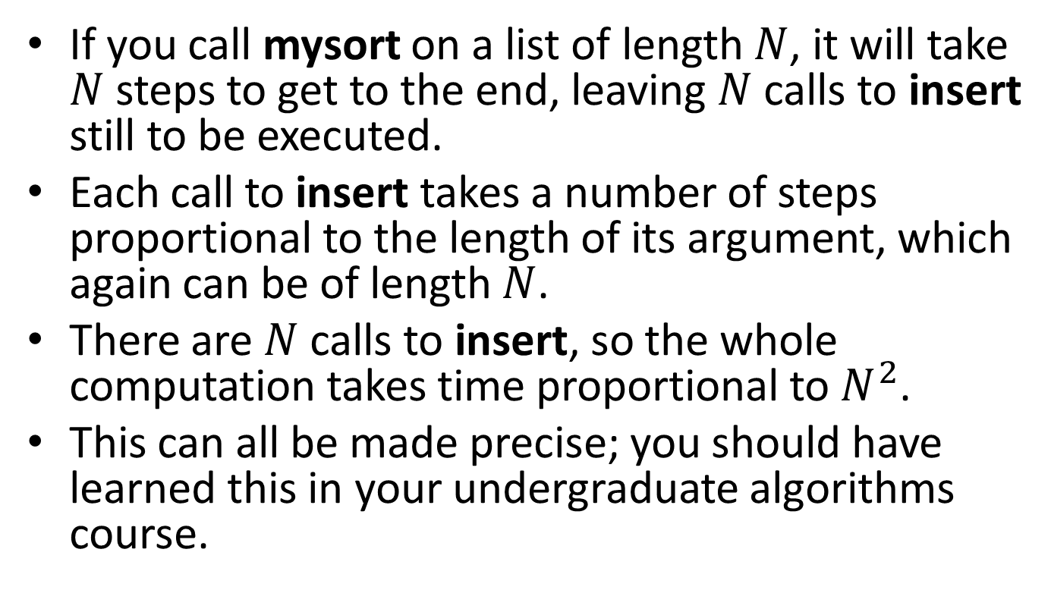
How many steps does this take?
If you call mysort on a list of length $N$, it will take $N$ steps to get to the end, leaving $N$ calls to insert still to be executed.
Each call to insert takes a number of steps proportional to the length of its argument, which again can be of length $N$.
There are $N$calls to insert, so the whole computation takes time proportional to $N^{2}$.
This can all be made precise; you should have learned this in your undergraduate algorithms course.

Slide 65
Summary
You should now be able to:
write down the template for a list data definition
use structural decomposition to define simple functions on lists

Slide 66
Next Steps
If you have questions about this lesson, ask them on the Discussion Board
Do Guided Practice 4.3
Go on to the next lesson

Slide 67
Lists of Structures
CS 5010 Program Design Paradigms “Bootcamp”
Lesson 4.3
© Mitchell Wand, 2012-2014
This work is licensed under a Creative Commons Attribution-NonCommercial 4.0 International License.
TexPoint fonts used in EMF.
Read the TexPoint manual before you delete this box.: AAA

Slide 68
Introduction
Lists of structures occur all the time
Programming with these is no different:
write down the data definition, including interpretation and template
Follow the Recipe!

Slide 69
Learning Objectives
At the end of this lesson you should be able to:
write down a template for lists of compound data
use the template to write simple functions on lists of compound data

Slide 70
Programming with lists of structures
Programming with lists of structures is no different from programming with lists of scalars, except that we make one small change in the recipe for templates

Slide 71
Example: modeling a bookstore
Let's imagine a program to help manage a bookstore.
Let’s build a simple model of the inventory of a bookstore.

Slide 72
Step 1: Data Design
First, we’ll give data definitions for the various quantities we need to represent:

Slide 73
Preliminary Data Definitions
;; An Author is represented as a String (any string will do)
;; A Title is represented as a String (any string will do)
;; An International Standard Book Number (ISBN) is represented
;; as a positive integer (PosInt).
;; A DollarAmount is represented as an integer,
;; INTERP: the amount in USD*100.
;; eg: the integer 3679 represents the dollar amount $36.79
;; A DollarAmount may be negative.
We might refine this definition later, eg keep track of FirstName, LastName, etc.
Actually, an ISBN is a sequence of exactly 13 digits, divided into four fields (see https://en.wikipedia.org/wiki/International_Standard_Book_Number).
We don't need to represent all this information, so we will simply represent it as a PosInt.

Slide 74
BookStatus
;; A BookStatus is represented as
;; (book-status isbn author title cost price on-hand)
;; INTERP:
;; isbn : ISBN -- the ISBN of the book
;; author : Author -- the book's author
;; title : Title -- the book's title
;; cost : DollarAmount -- the wholesale cost of the book (how much
;; the bookstore paid for each copy of the
;; book
;; price : DollarAmount -- the price of the book (how much the
;; bookstore charges a customer for the
;; book)
;; on-hand: NonNegInt -- the number of copies of the book that are
;; on hand in the bookstore)
Note that we are not modelling a Book (that’s something that exists on a shelf somewhere ☺). We are modelling the status of all copies of this book.

Slide 75
BookStatus (cont’d)
;; IMPLEMENTATION:
(define-struct book-status (isbn author title cost price on-hand))
;; CONSTRUCTOR TEMPLATE:
;; (make-book-status ISBN Author Title DollarAmount DollarAmount NonNegInt)
;; OBSERVER TEMPLATE:
;; book-status-fn : BookStatus -> ??
(define (book-status-fn b)
(...
(book-status-isbn b)
(book-status-author b)
(book-status-title b)
(book-status-cost b)
(book-status-price b)
(book-status-on-hand b)))

Slide 76
Inventory
;; An Inventory is represented as a list of
;; BookStatus, in increasing ISBN order, with at
;; most one entry per ISBN.
;; CONSTRUCTOR TEMPLATES:
;; empty
;; (cons bs inv)
;; -- WHERE
;; bs is a BookStatus
;; inv is an Inventory
;; and
;; (bookstatus-isbn bs) is less than the ISBN of
;; any book in inv.

Slide 77
Inventory (cont’d)
;; OBSERVER TEMPLATE:
;; inv-fn : Inventory -> ??
(define (inv-fn inv)
(cond
[(empty? inv) ...]
[else (...
(first inv)
(inv-fn (rest inv)))]))

Slide 78
Inventory (cont’d)
(define (inv-fn inv)
(cond
[(empty? inv) ...]
[else (...
(book-status-fn (first inv))
(inv-fn (rest inv)))]))
Since (first inv) is a BookStatus, it would also be OK to write the observer template like this. These templates are there to serve as a guide for you, so we going to try not to be too picky about them.
But you must put the recursive call to inv-fn in your observer template.

Slide 79
Example function: inventory-authors
;; inventory-authors : Inventory -> AuthorList
;; GIVEN: An Inventory
;; RETURNS: A list of the all the authors of the books in the
;; inventory. Repetitions are allowed. Books with no copies in stock
;; are included. The authors may appear in any order.
;; EXAMPLE: (inventory-authors inv1)
= (list "Felleisen" "Wand" "Shakespeare" "Shakespeare")
;; STRATEGY: Use observer template for Inventory
(define (inventory-authors inv)
(cond
[(empty? inv) empty]
[else (cons
(book-status-author (first inv))
(inventory-authors (rest inv)))]))

Slide 80
An Inventory– but which inventory?
So far we've decided how to represent an inventory.
But what store is it the inventory of?
And what date does it represent?

Slide 81
BookstoreState
;; A Date is represented as a ....
;; A BookstoreState is represented as a (bookstore-state date stock)
;; INTERP:
;; date : Date -- the date we are modelling
;; stock : Inventory -- the inventory of the bookstore as of 9am ET on
;; the given date.
;; IMPLEMENTATION:
(define-struct bookstore-state (date stock))
;; CONSTRUCTOR TEMPLATE
;; (make-bookstore-state Date Inventory)
;; OBSERVER TEMPLATE
;; state-fn : BookstoreState -> ??
(define (state-fn bss)
(... (bookstore-state-date bss)
(bookstore-state-stock bss)))
Now that we have a history of the inventory, we can do more things, like track the value of the inventory over time, compare the sales of some book over some time period, etc., etc.

Slide 82
Module Summary: Self-Referential or Recursive Information
Represent arbitrary-sized information using a self-referential (or recursive) data definition.
Self-reference in the data definition leads to self-reference in the observer template.
Self-reference in the observer template leads to self-reference in the code.
Writing functions on this kind of data is easy: just Follow The Recipe!
But get the template right!

Slide 83
Summary
At the end of this lesson you should be able to:
write down a template for lists of compound data
use the template to write simple functions on lists of compound data
The Guided Practices will give you some exercise in doing this.

Slide 84
Next Steps
Study 04-2-books.rkt in the Examples file
If you have questions about this lesson, ask them on the Discussion Board
Do Guided Practice 4.4
Go on to the next lesson

Slide 85
Recurring on the Natural Numbers
CS 5010 Program Design Paradigms “Bootcamp”
Lesson 4.4
© Mitchell Wand, 2016
This work is licensed under a Creative Commons Attribution-NonCommercial 4.0 International License.
TexPoint fonts used in EMF.
Read the TexPoint manual before you delete this box.: AAA

Slide 86
The Natural Numbers
The natural numbers are the counting numbers:
0, 1, 2, 3, 4, ...
This is just another name for the non-negative integers

Slide 87
A data definition for the natural numbers
;; A Nat is a natural number, represented as a Racket
;; integer.
;; CONSTRUCTOR TEMPLATES:
;; -- 0
;; -- (add1 n) WHERE n is a Nat
;; INTERP: self-evident
Here we use the Racket function add1, which adds 1 to its argument. We'll also use sub1, which subtracts 1 from its argument.

Slide 88
Examples
0
1 (because 1 = (add1 0))
2 (because 2 = (add1 1))
3 (because 3 = (add1 2))
4 (because 4 = (add1 3))
Etc...

Slide 89
Is this a good data definition?
Every natural number is either 0 or (add1 y) for some natural number y, and these two possibilities are mutually exclusive.
If we have a natural number x of the form (add1 y), there's only one possible value of y, namely (sub1 x).
So add1 is like a constructor, and sub1 is like an observer.
This leads us to an observer template:

Slide 90
Template
;; nat-fn : Nat -> ??
(define (nat-fn n)
(cond
[(zero? n) ...]
[else (... (nat-fn (sub1 n)))]))

Slide 91
double
;; double : Nat -> Nat
;; strategy: use template for
;; Nat on n
(define (double n)
(cond
[(zero? n) 0]
[else (+ 2 (double (sub1 n)))]))

Slide 92
sum
;; sum : Nat Nat -> Nat
;; strategy: use template for
;; Nat on x
(define (sum x y)
(cond
[(zero? x) y]
[else (add1 (sum (sub1 x) y))]))

Slide 93
Example
(sum 3 2)
= (add1 (sum 2 2))
= (add1 (add1 (sum 1 2)))
= (add1 (add1 (add1 (sum 0 2))))
= (add1 (add1 (add1 2)))
= 5

Slide 94
product
;; prod : Nat Nat -> Nat
;; strategy: use template for
;; Nat on y
(define (prod x y)
(cond
[(zero? y) 0]
[else
(sum x (prod x (sub1 y)))]))

Slide 95
Example
(prod 2 3)
= (sum 2 (prod 2 2))
= (sum 2 (sum 2 (prod 2 1)))
= (sum 2 (sum 2 (sum 2 (prod 2 0))))
= (+ 2 (+ 2 (+ 2 0)))
= 6

Slide 96
factorial
;; fact : Nat -> Nat
;; GIVEN: a natural number n
;; RETURNS: its factorial
(define (fact n)
(cond
[(zero? n) 1]
[else (prod n (fact (sub1 n)))]))
How could we talk about recursive functions without writing factorial? ☺
Here we've written prod instead of *, just to emphasize that we can do anything we want just using the primitive functions we've built.

Slide 97
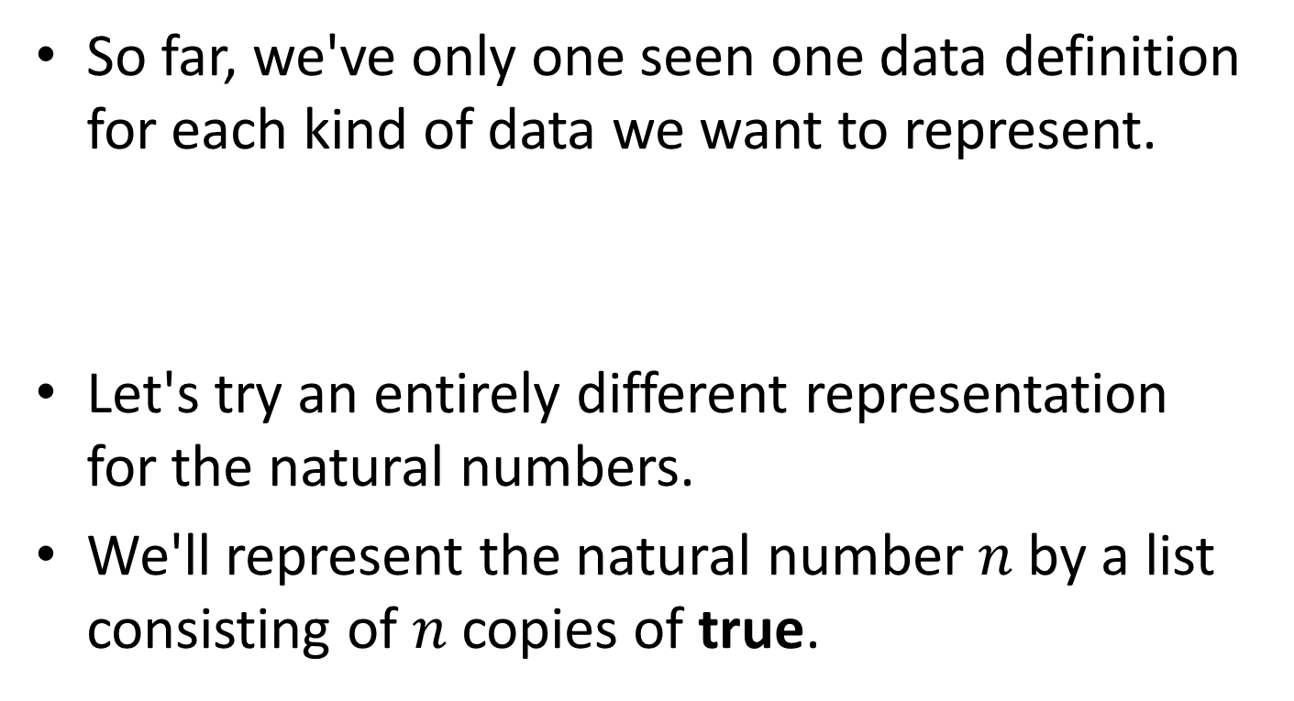
A different data definition for the natural numbers
So far, we've only one seen one data definition for each kind of data we want to represent.
Let's try an entirely different representation for the natural numbers.
We'll represent the natural number $n$ by a list consisting of $n$ copies of true.
Well, not quite: we could certainly change any of our data definitions by changing the name of the structure, changing field names, or changing the order of the fields, but that's not much of a change ☺

Slide 98
The data type LNat
;; An LNat is a natural number, represented as a list of "true"s.
;; CONSTRUCTOR TEMPLATES:
;; -- empty
;; -- (cons true ln)
;; WHERE ln is a LNat
;; INTERP:
;; empty represents 0
;; if ln represents n, then (cons true ln) represents n+1
;; OBSERVER TEMPLATE:
;; lnat-fn : LNat -> ??
(define (lnat-fn n)
(cond
[(empty? n) ...]
[else (...
(lnat-fn (rest n)))]))

Slide 99
Useful help functions
;; succ : LNat -> LNat
;; GIVEN: an LNat representing n
;; RETURNS: an LNat representing n+1
(define (succ ln) (cons true ln))
;; pred : LNat -> LNat
;; GIVEN: an LNat representing a natural number n > 0
;; RETURNS: an LNat representing n-1
(define (pred ln) (rest ln))
It's useful to define some help functions, so we don't have to spend our time worrying about the details of the data representation.

Slide 100
Another useful help function
This function will be handy for constructing tests. We won't use it for anything else.
;; nat-to-lnat : Nat -> LNat
;; GIVEN: A Nat n
;; RETURNS: An LNat representing n
;; EXAMPLES:
;; (nat-to-lnat 0) = empty
;; (nat-to-lnat 3) = (list true true true)
;; STRATEGY: Use template for Nat on n
(define (lnat n)
(cond
[(zero? n) empty]
[else (cons true (lnat (sub1 n)))]))

Slide 101
double on LNats
;; double : LNat -> LNat
;; GIVEN: An LNat representing n
;; RETURNS: An LNat representing 2*n
;; STRATEGY: use observer template for LNat
(define (double n)
(cond
[(empty? n) 0]
[else (succ (succ (double (pred n))))]))
Compare this to the definition of double for Nats.

Slide 102
sum on LNats
;; sum : LNat LNat -> LNat
;; RETURNS: an LNat representing the sum of its
;; arguments
;; STRATEGY: use observer template for LNat on x
(define (sum x y)
(cond
[(empty? x) y]
[else (succ (sum (pred x) y))]))

Slide 103
Tests for sum
(begin-for-test
(check-equal? (sum (lnat 0) (lnat 4))
(lnat 4))
(check-equal? (sum (lnat 3) (lnat 2))
(lnat (+ 3 2)))
(check-equal? (sum (lnat 27) (lnat 18))
(lnat (+ 27 18))))
Explain why these are the correct tests for sum.
Why is it better to write (lnat 4) instead of (list true true true true) ?
Why is it better to write (lnat (+ 27 18)) instead of (lnat 45) ?

Slide 104
prod for LNats
;; prod : LNat LNat -> LNat
;; RETURNS: An LNat representing the product of its arguments
;; STRATEGY: use observer template for LNat on y
(define (prod x y)
(cond
[(empty? y) empty]
[else
(sum x (prod x (pred y)))]))
(begin-for-test
(check-equal? (prod (lnat 0) (lnat 4))
(lnat 0))
(check-equal? (prod (lnat 3) (lnat 2))
(* (lnat 3) (lnat 2)))
(check-equal? (prod (lnat 27) (lnat 18))
(* (lnat 27) (lnat 18))))

Slide 105
Would you ever want to use Lnats?
Well, no, not likely.
But it illustrates the point that information can be represented in different ways.
So far, you probably haven't faced many choices in your data design
But eventually you will get to situations where you will have to make decisions about your data design.
We'll come back to this when we get to the topic of modularity later in the course.

Slide 106
Summary
We've seen how to represent the natural numbers as a data type in two different ways.
We've seen how to use the observer template to write recursive functions over the natural numbers.
The Guided Practices will give you some exercise in doing this.

Slide 107
Next Steps
Study 04-3-nats.rkt in the Examples file
If you have questions about this lesson, ask them on the Discussion Board
Do Guided Practice 4.4
Go on to the next lesson

Slide 108
Non-Empty Lists
CS 5010 Program Design Paradigms “Bootcamp”
Lesson 4.5
© Mitchell Wand, 2012-2014
This work is licensed under a Creative Commons Attribution-NonCommercial 4.0 International License.
TexPoint fonts used in EMF.
Read the TexPoint manual before you delete this box.: AAA

Slide 109
Lesson Introduction
In this lesson, we'll learn about non-empty lists, another example of recursive data

Slide 110
Empty lists
Most computations on lists make sense on empty lists
(sum empty) = 0
(product empty) = 1
(double-all empty) = empty
etc, etc.

Slide 111
Non-empty lists
But some computations don't make sense for empty lists
min, max
average

Slide 112
Non-Empty Lists
For these problems, the constructor and observer templates for lists don't make sense, either.
For these problems, we can use a different data definition and that is suited for dealing with lists that are always non-empty.
Let's imagine we've defined a data type called Sardine, and we want to work with non-empty lists of Sardines.

Slide 113
Constructor Templates for Non-Empty List of Sardines
;; A NonEmptyListOfSardines is one of
;; -- (cons Sardine empty)
;; -- (cons Sardine
;; NonEmptyListOfSardines)

Slide 114
Observer Template for Non-Empty List
;; neseq-fn : NonEmptyListOfSardines -> ??
(define (nelos-fn ne-lst)
(cond
[(empty? (rest ne-lst)) (... (first ne-lst))]
[else (...
(first ne-lst)
(nelos-fn (rest ne-lst)))]))
(rest ne-lst) is a NonEmptyListOfSardines
so call nelos-fn on it

Slide 115
Template Questions for Non-Empty Lists
;; neseq-fn : NonEmptyListOfSardines -> ??
(define (nelos-fn ne-lst)
(cond
[(empty? (rest ne-lst)) (... (first ne-lst))]
[else (...
(first ne-lst)
(los-fn (rest ne-lst)))]))
What is the answer for a list of length 1?
If we knew the answer for the rest of the list, and we knew the first of the list, how could we combine them to get the answer for the whole list?

Slide 116
Non-Empty Lists: The General Pattern
CONSTRUCTOR TEMPLATES for NonEmptyXList
-- (cons X empty)
-- (cons X NonEmptyXList)
In your assignments, you don't need to write down a separate interpretation for NonEmptyXList; a NonEmptyXList always represents a non-empty sequence of X's in the standard way.

Slide 117
Template Questions for Non-Empty Lists
;; nelst-fn : NonEmptyXList -> ??
(define (nelst-fn ne-lst)
(cond
[(empty? (rest ne-lst)) (.... (first ne-lst))]
[else (...
(first ne-lst)
(nelst-fn (rest ne-lst)))]))
What is the answer for a list of length 1?
If we knew the answer for the rest of the list, and we knew the first of the list, how could we combine them to get the answer for the whole list?

Slide 118
Example: max
;; seq-max : NonEmptyListOfInteger -> Integer
;; GIVEN: a non-empty list of integers,
;; RETURNS: the largest element of the list
(define (seq-max ne-lst)
(cond
[(empty? (rest ne-lst)) (first ne-lst)]
[else (max
(first ne-lst)
(seq-max (rest ne-lst)))]))

Slide 119
Example: average
ns-avg : NumberSeq -> Number
Given a non-empty NumberSeq, returns its average
(ns-avg (cons 11 empty)) = 11
(ns-avg (cons 33 (cons 11 empty))) = 22
(ns-avg (cons 33 (cons 11 (cons 11 empty)))) = 55/3

Slide 120
Example: average
;; ns-avg : NENumberSeq -> Number
;; Given a non-empty NumberSeq, returns its average
;; strategy: structural decomposition
(define (ns-avg ne-lst)
(cond
[(empty? (rest ne-lst)) (first ne-lst)]
[else (....
(first ne-lst)
(ns-avg (rest ne-lst)))]))
If we knew the answer for the rest of the list, and we knew the first of the list, how could we combine them to get the answer for the whole list?

Slide 121
But wait: there's no way to answer that question!
(ns-avg (list 33 11 11)) = 55/3
➔ (... 33 11) = 55/3
(ns-avg (list 33 11)) = 22
➔ (... 33 11) = 22
Can't have both!
Here are two lists. They have the same first element (33), and the average of their rests is the same (11). But they have different averages. So there's no way to combine 33 and 11 that will give the right answer for both examples. So simply using the template can't possibly work.
11

Slide 122
Try something simpler!
ns-avg : NENumberSeq -> Number
Given a non-empty NumberSeq, returns its average
Strategy: combine simpler functions
(define (ns-avg lst)
(/ (ns-sum lst) (ns-length lst)))
Here we had a problem that could not be solved by blindly following the template.
But we could still solve it by dividing it into simpler pieces and combining the answers for the pieces. Watch out for situations like this!

Slide 123
Remember, don't use non-empty lists unless you really need to
The vast majority of problems make sense for the empty list.
Make your data definitions in the form XList if that make sense (even if the list in the problem never happens to be empty).
If you're using a NonEmptyXList template, and you have duplicated code, that's a sign that it should be a plain old XList.

Slide 124
Summary
You should now be able to explain the difference between a list of items and a non-empty list of items
You should be able to write down the template for a non-empty list and use it.

Slide 125
Next Steps
If you have questions about this lesson, ask them on the Discussion Board
Do Problem Set 04

Slide 126
More About Recursive Data Types
CS 5010 Program Design Paradigms “Bootcamp”
Lesson 4.5
© Mitchell Wand, 2016
This work is licensed under a Creative Commons Attribution-NonCommercial 4.0 International License.
TexPoint fonts used in EMF.
Read the TexPoint manual before you delete this box.: AAA

Slide 127
Introduction
We've just seen several examples of data definitions for recursive data
For each one, we wrote down a set of constructor templates and an observer template.
In upcoming modules, we'll be doing a lot more of this, so it will be useful to examine the characteristics of a good data type definition.

Slide 128
Key Points for Lesson 4.6
TK.

Slide 129
Multiple constructors
In order to define recursive data, we introduced data definitions with multiple constructors, e.g.:
;; CONSTRUCTOR TEMPLATES:
;; -- 0
;; -- (add1 n) WHERE ...
;; CONSTRUCTOR TEMPLATES:
;; empty
;; (cons bs inv)
;; -- WHERE ...
CONSTRUCTOR TEMPLATES
for NonEmptyXList:
-- (cons X empty)
-- (cons X NonEmptyXList)

Slide 130
Properties of a good data definition for recursive data
There is an interpretation for each case.
There are one or more base cases that do not use recursion
The cases are mutually exclusive
It is easy to tell the alternatives apart
There is one and only one way of building any value.

Slide 131
Did our definitions have these properties?
Go back now and check to see that our definitions have these properties.
All the definitions we (and you) will write will have these properties.
But just for contrast, let's look at some bad data definitions.

Slide 132
Example of a bad data definition
A Blue number is one of
an integer that is a multiple of two
an integer that is a multiple of three
These categories are not mutually exclusive, so there is no way to write an observer template.

Slide 133
Example of a bad data definition
A Green number is one of
an integer that is a product of exactly two prime numbers
any other integer
These categories are mutually exclusive, but it is complicated to distinguish them. It would be possible, though difficult, to write an observer template for this data type.

Slide 134
Example of a bad data definition
A Purple number is one of
the number 1
a number of the form (+ n1 n2), where n1 and n2 are Purple numbers.
Just knowing the value of a purple number, like 56, doesn't tell you how it was constructed as (+ n1 n2) . There are many choices of n1 and n2 that would build 56.

Slide 135
Let's look again at our data definition for Nat
;; A Nat is a natural number, represented as a Racket
;; integer.
;; CONSTRUCTOR TEMPLATES:
;; -- 0
;; -- (add1 n) WHERE n is a Nat
;; INTERP: self-evident

Slide 136
Is this a good data definition? Let's check the properties
Is there an interpretation for each case? Yes.
Are there one or more base cases that do not use recursion? Yes.
Are the cases are mutually exclusive? Yes.
Is it easy to tell the alternatives apart? Yes, with the predicate zero?
Is there one and only one way of building any value? (Answer on next slide)

Slide 137
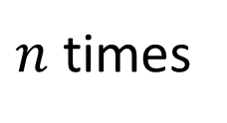
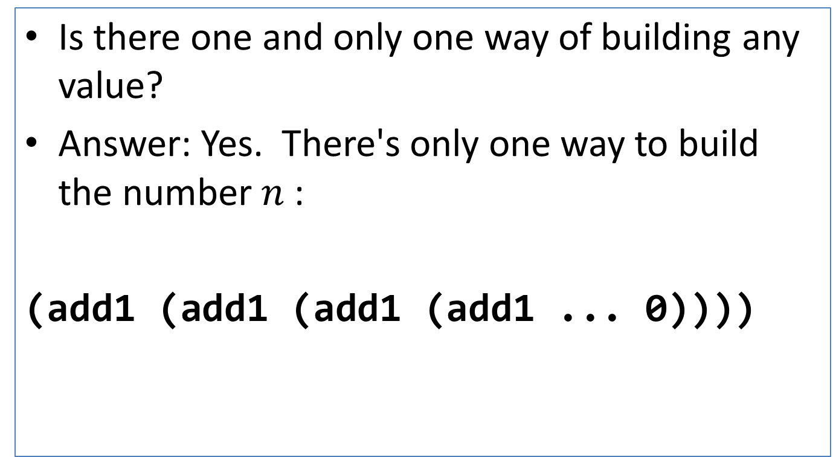
Is this a good data definition? (2)
Is there one and only one way of building any value?
Answer: Yes. There's only one way to build the number $n$ :
(add1 (add1 (add1 (add1 ... 0))))
$n$ times

Slide 138
Is this a good data definition? (3)
If we have a natural number x of the form (add1 y), there's only one possible value of y. Can we find it?
Answer: sure. If x = (add1 y), then y = (sub1 x).
This leads us to our observer template:

Slide 139
Observer Template
;; nat-fn : Nat -> ??
(define (nat-fn n)
(cond
[(zero? n) ...]
[else (... (nat-fn (sub1 n)))]))

Slide 140
Why Recursive Functions Halt
CS 5010 Program Design Paradigms “Bootcamp”
Lesson 4.6
© Mitchell Wand, 2016
This work is licensed under a Creative Commons Attribution-NonCommercial 4.0 International License.
TexPoint fonts used in EMF.
Read the TexPoint manual before you delete this box.: AAA

Slide 141
Introduction
All of our functions so far always terminated.
But recursive functions need not terminate!
In this lesson, we'll study a property that guarantees that a function always halts.
This property is called "having a halting measure"
We'll see how to document the halting measure for your function.

Slide 142
Learning Objectives
At the end of this lesson you should be able to:
Identify the halting measure for functions that follow a template
Document the halting measure for such functions

Slide 143
Remember ns-sum
ns-sum : NumberSeq -> Number
(define (ns-sum lst)
(cond
[(empty? lst) 0]
[else (+ (first lst)
(ns-sum (rest lst)))]))

Slide 144
Watch this work:
(ns-sum (cons 11 (cons 22 (cons 33 empty))))
= (+ 11 (ns-sum (cons 22 (cons 33 empty))))
= (+ 11 (+ 22 (ns-sum (cons 33 empty))))
= (+ 11 (+ 22 (+ 33 (ns-sum empty))))
= (+ 11 (+ 22 (+ 33 0)))
= (+ 11 (+ 22 33))
= (+ 11 55)
= 66

Slide 145
Clearly, this function will halt for any NumberSeq
Why?
Because at every step it works on a shorter and shorter list, so eventually it reaches empty? and the function halts.
In other words, (length lst) is a quantity that decreases at every recursive call.

Slide 146
So here's a hypothesis
If we can find a quantity that decreases at every recursive call to our function, then the function always halts.

Slide 147
Another example: sum
;; sum :
;; NonNegInt NonNegInt -> NonNegInt
;; strategy: use template for
;; NonNegInt on x
(define (sum x y)
(cond
[(zero? x) y]
[else (+ 1 (sum (- x 1) y))])

Slide 148
Example
(sum 3 2)
= (+ 1 (sum 2 2))
= (+ 1 (+ 1 (sum 1 2)))
= (+ 1 (+ 1 (+ 1 (sum 0 2))))
= (+ 1 (+ 1 (+ 1 2)))
= 5

Slide 149
This one will also work for any non-negative integer x
At every recursive call, the value of the first argument decreases, so eventually it reaches 0.
The value of x is a quantity that decreases at every recursive call.
So this example is consistent with our hypothesis.

Slide 150
Let's look at another example
;; foo : NonNegReal -> NonNegInt
(define (foo n)
(cond
[(zero? n) 0]
[else (+ 1 (foo (* n 0.1)))]))
This is a silly function, so we won't write out the rest of the purpose statement.

Slide 151
(foo 3)
= (+ 1 (foo 0.3))
= (+ 1 (+ 1 (foo 0.03)))
= (+ 1 (+ 1 (+ 1 (foo 0.003))))
= ...
Oops! The argument is never equal to 0, so the function never halts.

Slide 152
So we can refine our hypothesis
If we can find a integer-valued quantity that decreases at every recursive call to our function, then the function always halts.
All our examples are consistent with this hypothesis.

Slide 153
Let's try another example
;; sum2 :
;; NonNegInt NonNegInt -> NonNegInt
;; strategy: use template for
;; NonNegInt on x
(define (sum2 x y)
(cond
[(zero? x) y]
[else (+ 2 (sum2 (- x 2) y))])
What if we had used the template incorrectly, and written this program instead?

Slide 154
It still works for even x
(sum2 4 3)
= (+ 2 (sum2 2 3))
= (+ 2 (+ 2 (sum2 0 3)))
= (+ 2 (+ 2 3))
= 7

Slide 155
But watch what happens when x is odd
(sum2 3 3)
= (+ 2 (sum2 1 3))
= (+ 2 (+ 2 (sum2 -1 3)))
= (+ 2 (+ 2 (+ 2 (sum2 -3 3))))
= (+ 2 (+ 2 (+ 2 (+ 2 (sum2 -5 3)))))
= ...
Oops! The value of x went negative without being 0. This goes into an infinite loop!

Slide 156
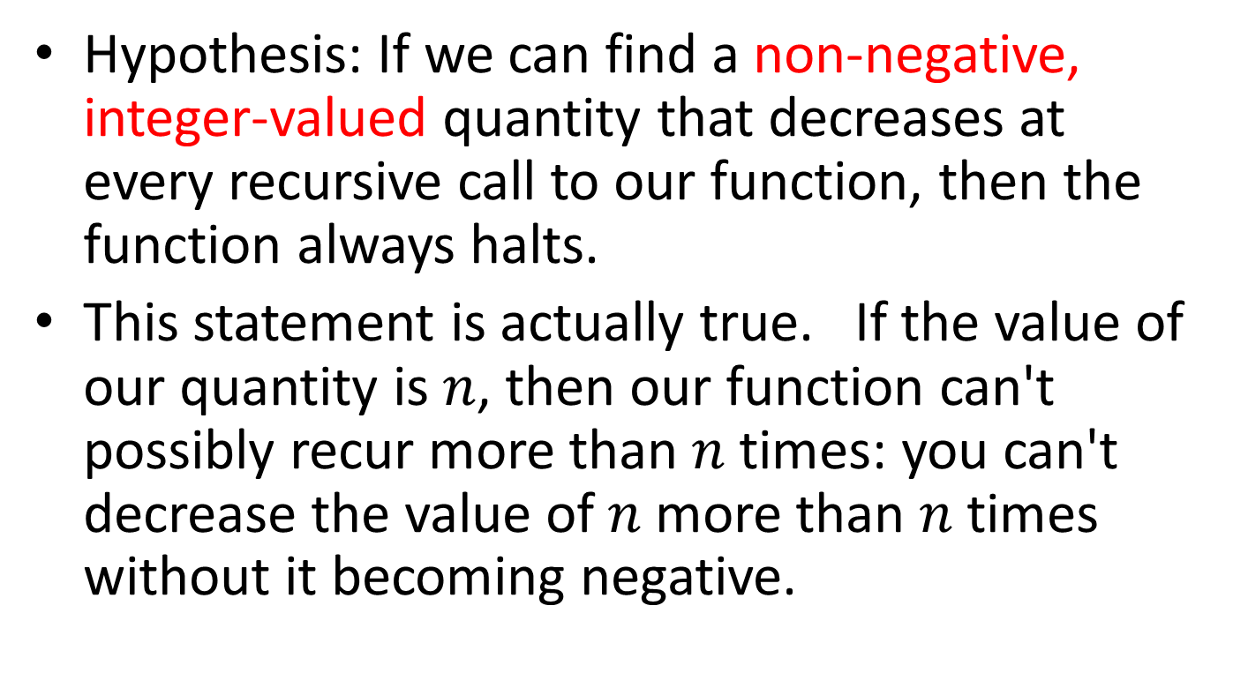
So let's refine our hypothesis again
Hypothesis: If we can find a non-negative, integer-valued quantity that decreases at every recursive call to our function, then the function always halts.
This statement is actually true. If the value of our quantity is $n$, then our function can't possibly recur more than $n$ times: you can't decrease the value of $n$ more than $n$ times without it becoming negative.

Slide 157
Halting Measure
Definition: a halting measure for a particular function is an integer-valued quantity that can't be less than zero, and which decreases at each recursive call in that function.
This is something you have probably not seen before, so you'll need to pay careful attention.

Slide 158
Examples
(length lst) is a halting measure for ns-sum
the value of x is a halting measure for sum
the value of y is a halting measure for prod (Lesson 4.4).

Slide 159
A function may have more than one halting measure
The following quantities are halting measures for sum:
the value of x
the value of x+4
the value of 2*x
The following quantities are not halting measures for sum:
the value of y
the value of -2*x
But usually there's one "obvious" halting measure, like the ones on the preceding slide.

Slide 160
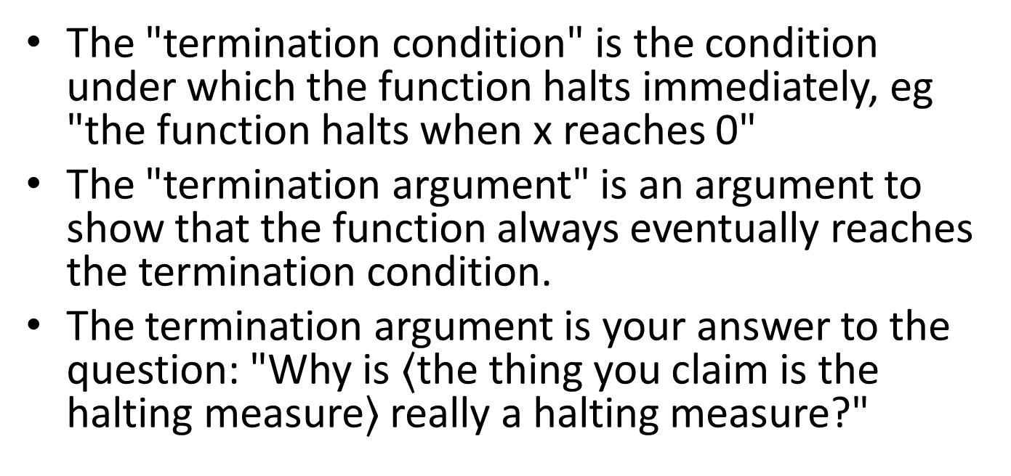
Don't get confused: "Termination Argument" vs. "Termination Condition"
The "termination condition" is the condition under which the function halts immediately, eg "the function halts when x reaches 0"
The "termination argument" is an argument to show that the function always eventually reaches the termination condition.
The termination argument is your answer to the question: "Why is $〈$the thing you claim is the halting measure$〉$ really a halting measure?"

Slide 161
The Halting Measure is a new deliverable
We will ask you to specify a halting measure for every recursive function you write.
This is usually easy, eg:
HALTING MEASURE: the length of lst
or the like.
When you follow the template, it will almost always be a quantity associated with the template variable.
The TA may ask you to explain why the thing you called the halting measure really is a halting measure for your function.

Slide 162
Summary
At the end of this lesson you should be able to:
Identify the halting measure for functions that follow a template
Document the halting measure for such functions

Slide 163
Next Steps
Study 04-XXX in the Examples file
If you have questions about this lesson, ask them on the Discussion Board
Do Guided Practice 4.4++
Go on to the next lesson
GPs: take some from Lesson 8.2, add some for lists.

Slide 164
Outtakes

Slide 165
Let's add this to the recipe for writing a template
Question | Answer
Does the data definition distinguish among different subclasses of data? | Your template needs as many cond clauses as subclasses that the data definition distinguishes.
How do the subclasses differ from each other? | Use the differences to formulate a condition per clause.
Do any of the clauses deal with structured values? | If so, add appropriate selector expressions to the clause.
Does the data definition use self-references? | Formulate ``natural recursions'' for the template to represent the self-references of the data definition.
We got the list template by following the template recipe and adding one more step.

Slide 166
Let's see how the four steps in the template recipe show up in the list template.
;; seq-fn : XList -> ??
(define (seq-fn lst)
(cond
[]
[]))
;; seq-fn : XList -> ??
(define (seq-fn lst)
(cond
[(empty? lst) ...]
[else ...]))
;; seq-fn : XList -> ??
(define (seq-fn lst)
(cond
[(empty? lst) ...]
[else (... (first lst)
(rest lst))]))
;; seq-fn : XList -> ??
(define (seq-fn lst)
(cond
[(empty? lst) ...]
[else (... (first lst)
(seq-fn (rest lst))]))
1. Write a cond clause with the correct number of clauses.
2. Write predicates that distinguish the cases.
3. For mixed data, add selectors
4. For recursive data, add a recursive call
1. Write a cond clause with the correct number of clauses.
2. Write predicates that distinguish the cases.
3. For mixed data, add selectors
4. For recursive data, add a recursive call
1. Write a cond clause with the correct number of clauses.
2. Write predicates that distinguish the cases.
3. For mixed data, add selectors
4. For recursive data, add a recursive call
1. Write a cond clause with the correct number of clauses.
2. Write predicates that distinguish the cases.
3. For mixed data, add selectors
4. For recursive data, add a recursive call
Observe that (cons X XList) was a structured value, and that (first lst) and (rest lst) were the appropriate selector expressions

Slide 167
From Observer Template to Function Definition
Remember that when we use a template, all we do is fill in the blanks.
For each blank, we had a question to answer:
"What's the answer for a red light?"
"What's the answer for a yellow light?"
"What's the answer for a green light?"
The questions are the same, no matter what the function is.

Slide 168
Template Questions for TLState
What's the answer for "red"?
;; tls-fn : TLState -> ??
;(define (tls-fn tls)
; (cond
; [(string=? tls "red") ...]
; [(string=? tls "yellow") ...]
; [(string=? tls "green") ...]))
What's the answer for "yellow"?
The questions are the same, no matter what function we are defining.
To finish the function definition, all we do is to fill in the blanks with the answers.
What's the answer for "green"?

